Slide 1
Tail CAD

Slide 2
Agenda
10 min — research ultralight tails and share
5 min — VT explanation
10 min — CAD VT
5 min — HT explanation
10 min — CAD VT
10 min — Pipe tail
10 min — peer reviews and share

Slide 3
Welcome back! We’re CADing again!

Slide 4
5 minutes — Research typical tail shapes for an ultralight

Slide 5
Anyone want to share what they found?

Slide 6
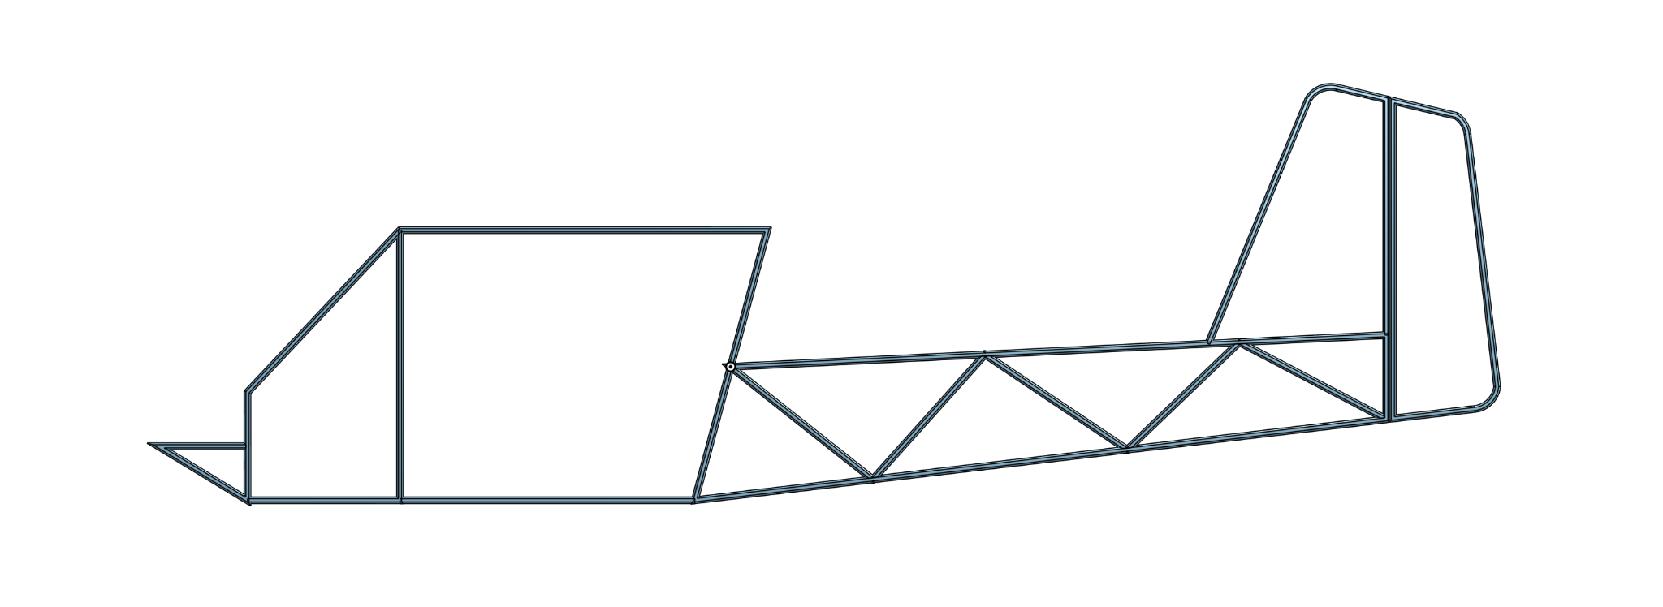
Open up your Affordaplane doc — we’ll be finishing it today

Slide 7
Vertical Tail
Rudder and vertical stabilizer

Slide 8
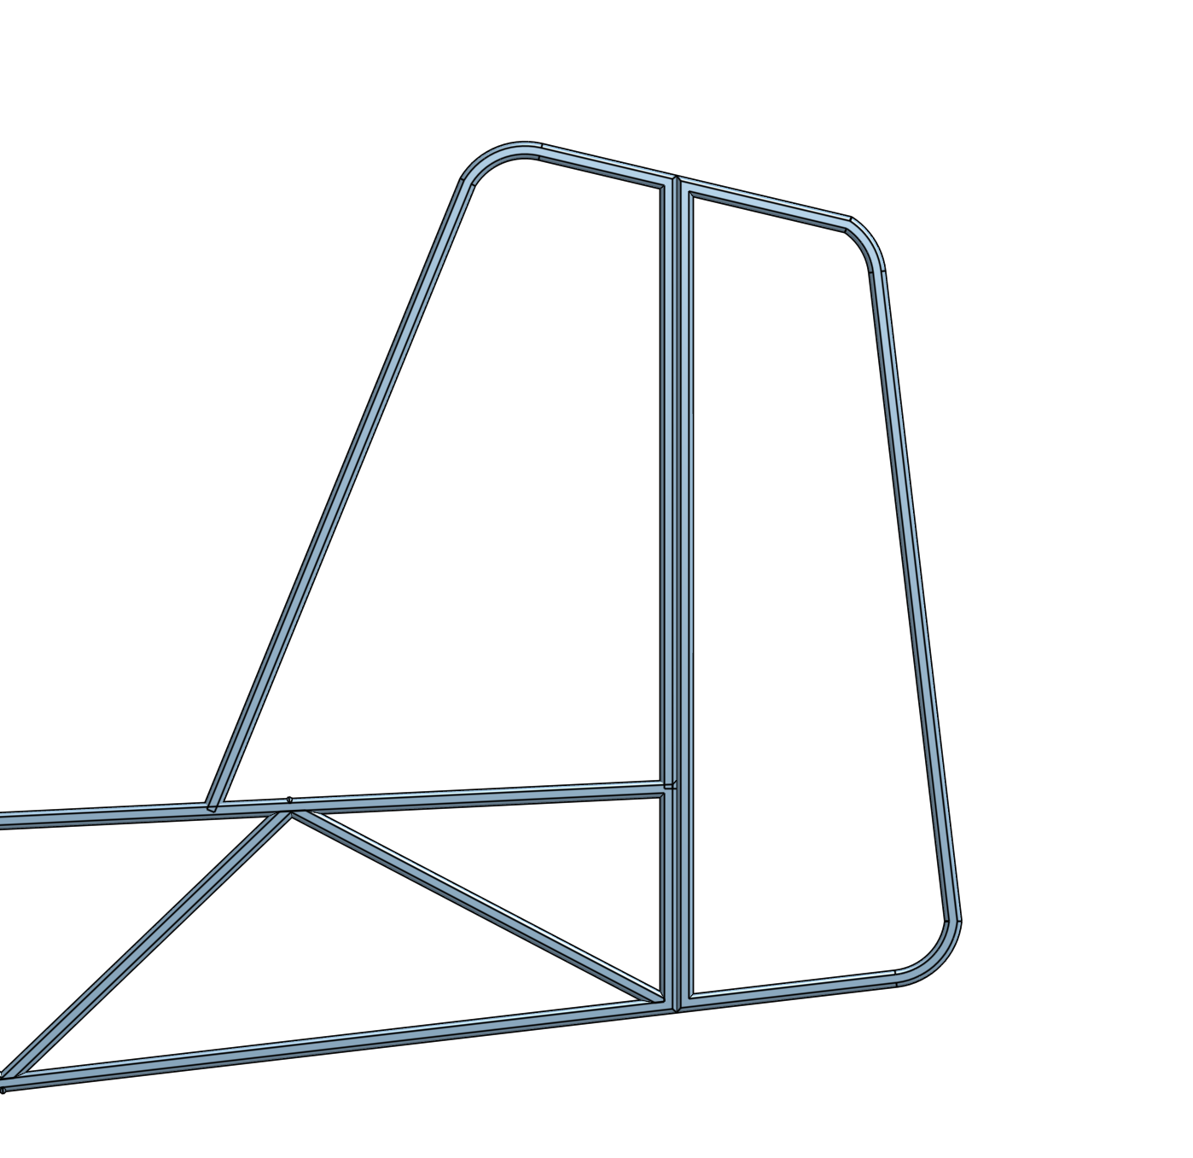
Got your idea? Ok, let’s go.
I’ll be showing you how to make this, but you can deviate from the instructions as much as you like.

Slide 9
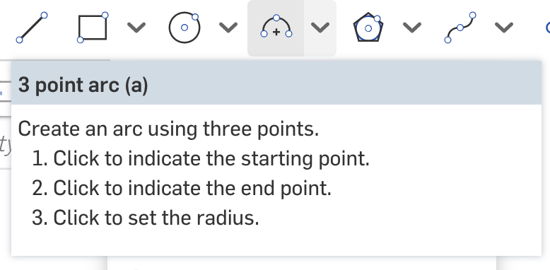

Arcs
Three-point arcs can be used for rounded corners for the tail.
Click the arc tool or press a.
Click two points for the endpoints of the arc, then another point for the center of the arc (imagine that the arc is part of a circle).

Slide 10
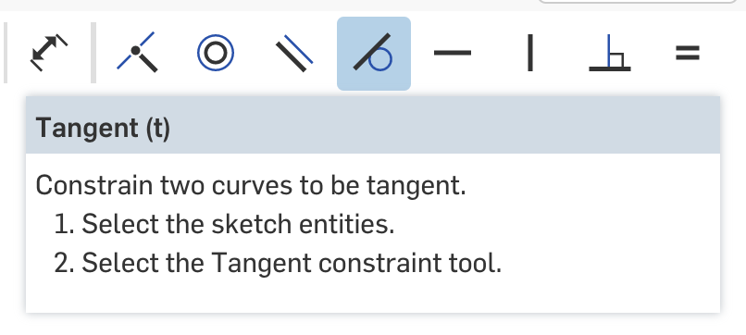
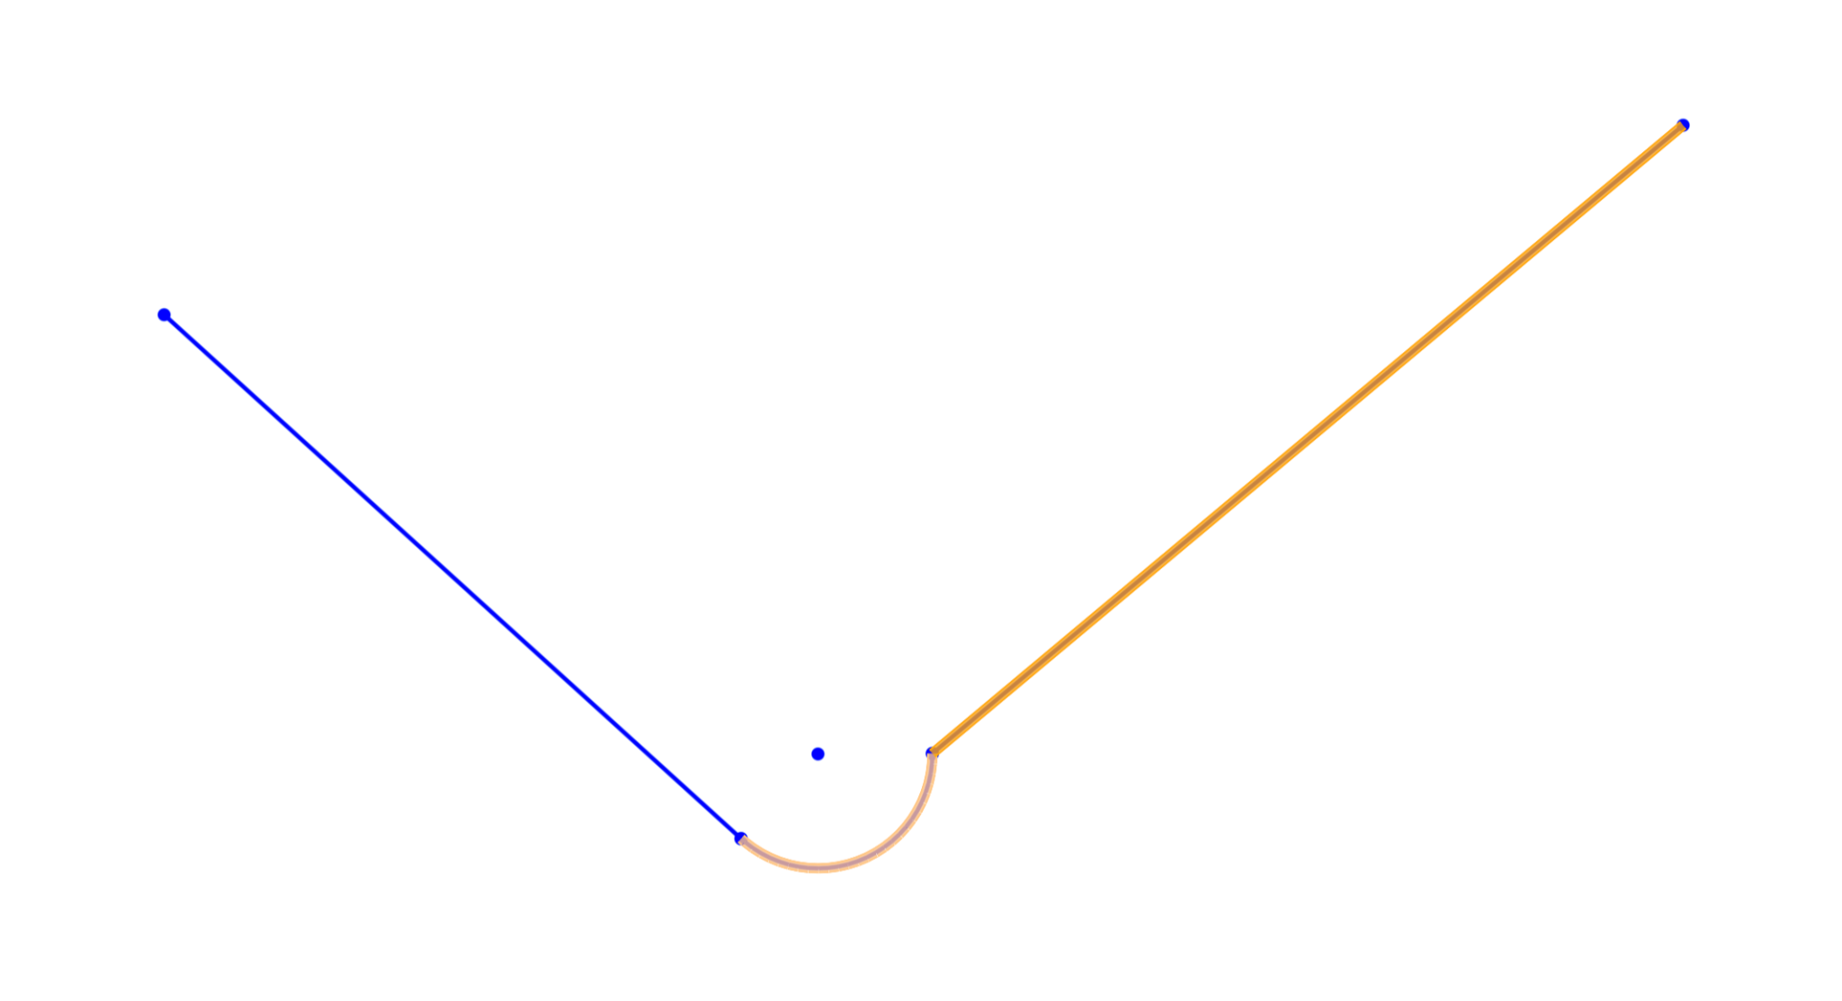
Tip — to make the rounded edges nice use the tangent constraint
Select the curve and the adjacent line

Slide 11
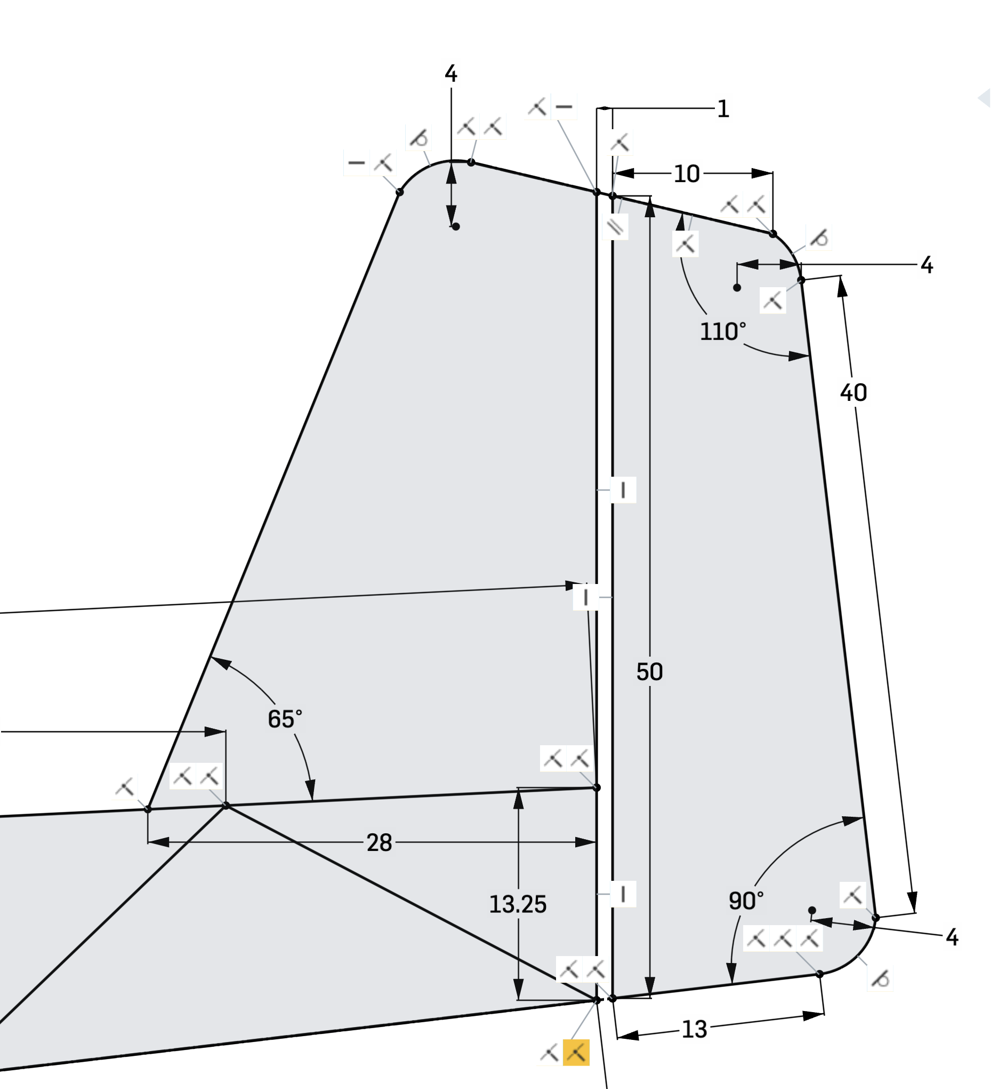
1d. Tail Constraints
Tangent constraint
15 minutes — enter the sketch you created your fuselage in and CAD your VT!

Slide 12
Horizontal Tail
Elevator and horizontal stabilizer

Slide 13
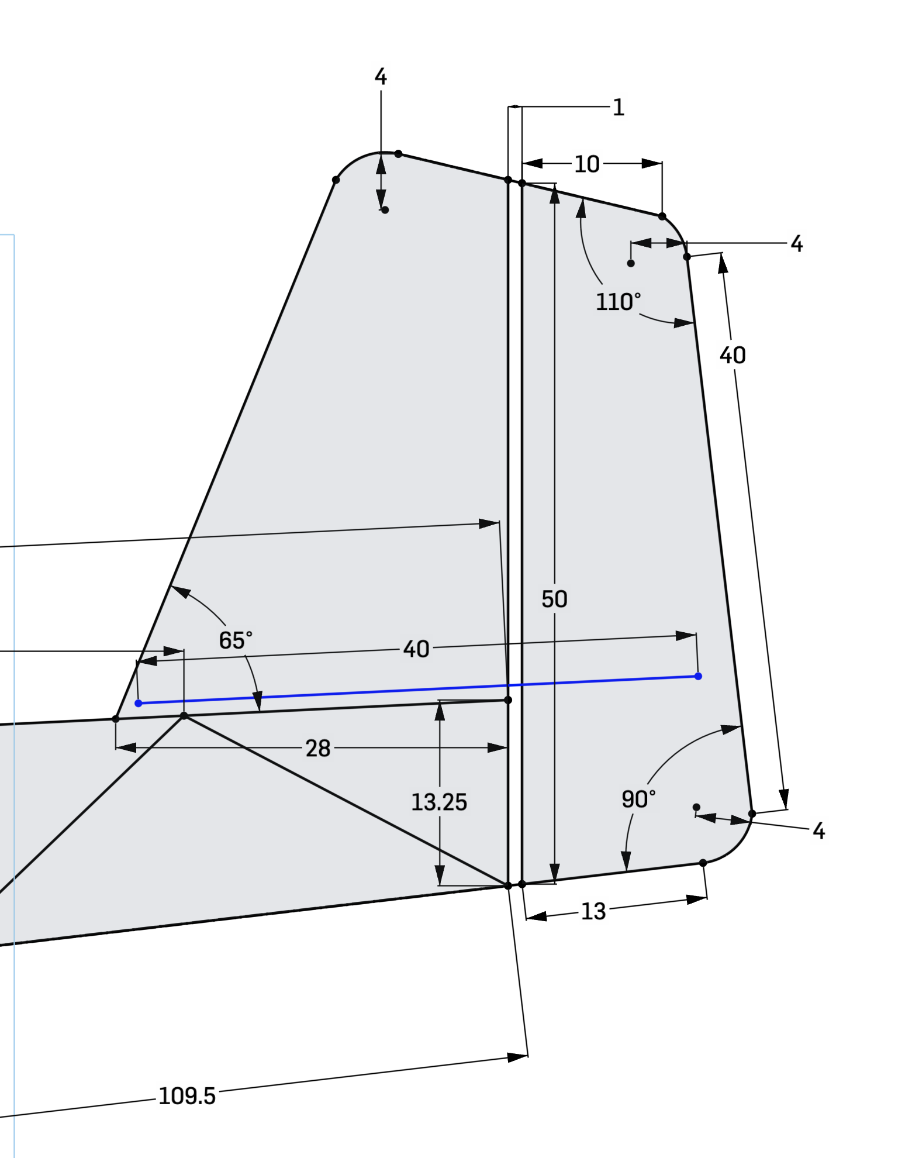
New Plane
We’ll need to create a new plane for the horizontal tail
Enter your sketch and draw a line where you want your HT to go.
The angle of this line will determine the angle of your HT — think about it.
Finish the sketch

Slide 14
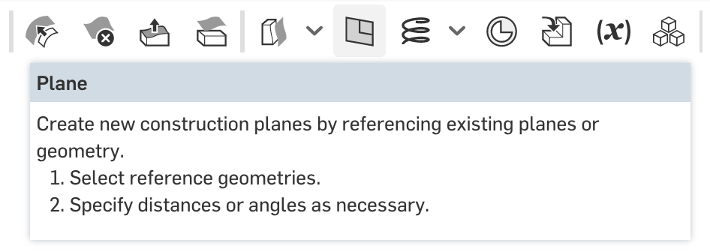
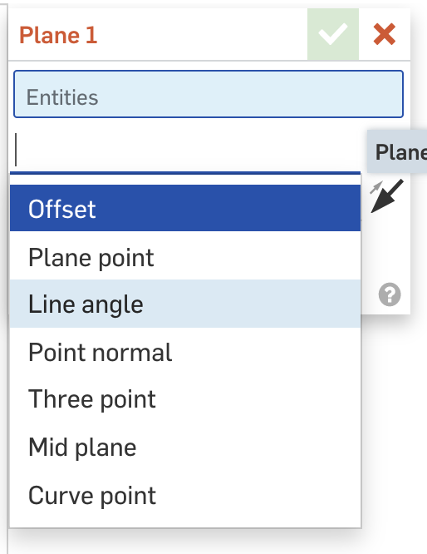
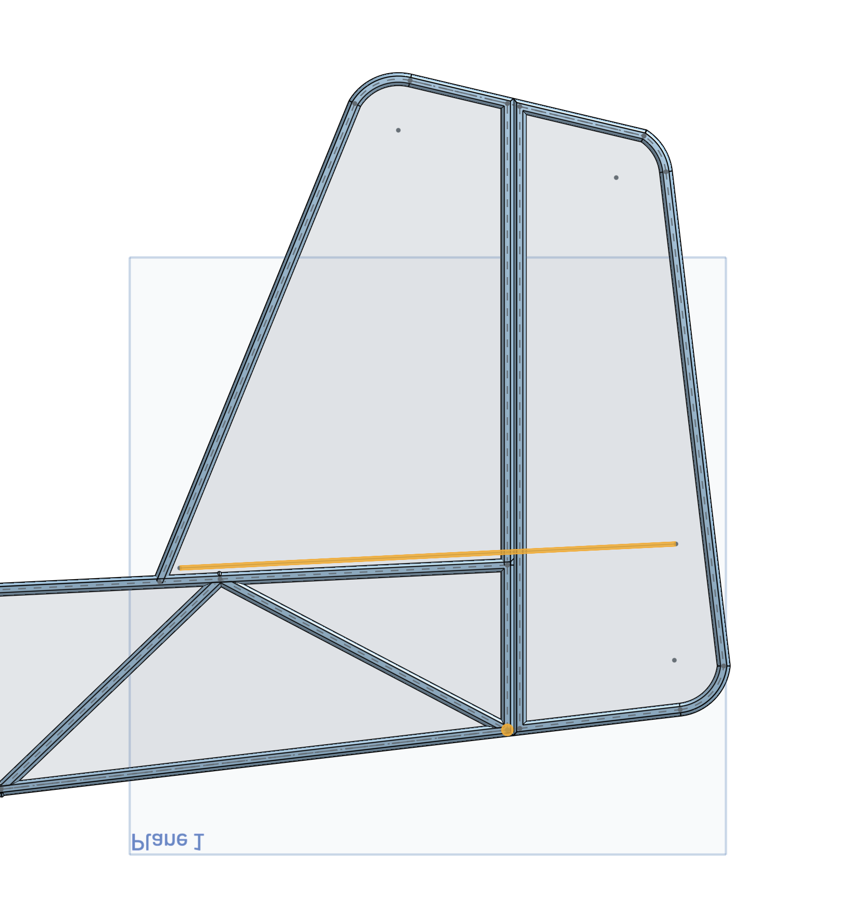
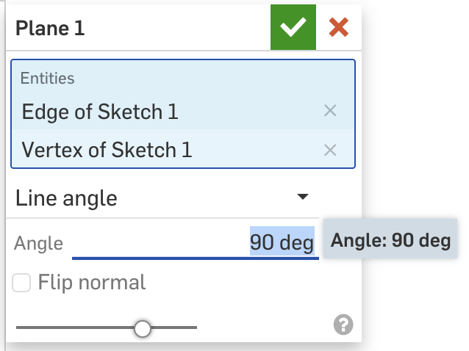
New Plane
Select the plane tool
Change “Offset” to “Line angle”
Click the line you drew to represent the HT, then click another point on the fuselage to measure the angle to.
Enter 90 for the angle (so the plane is perpendicular to your fuselage).

Slide 15
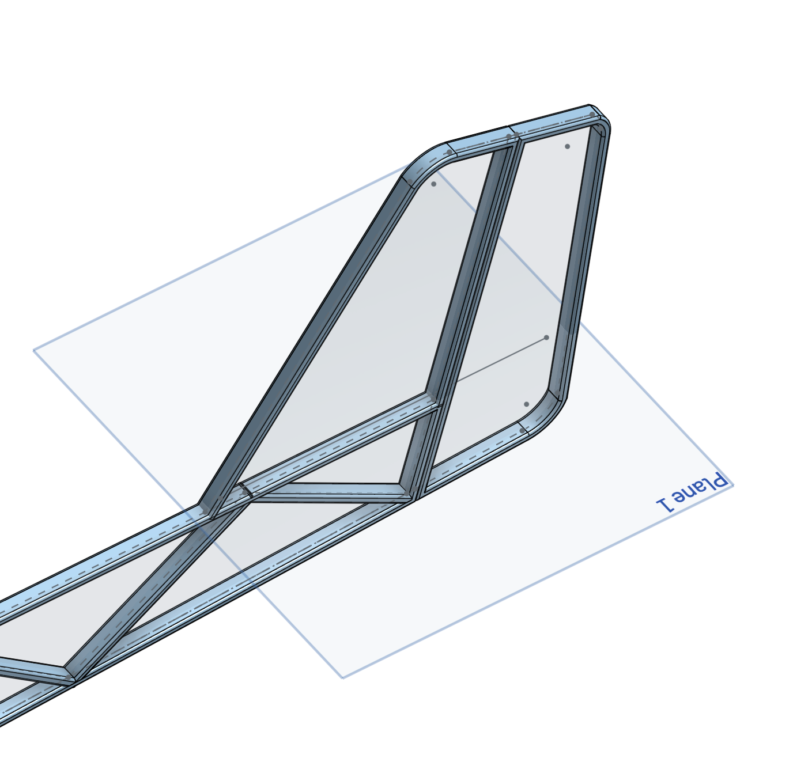
Plane complete! Now you can create a sketch and CAD your HT!

Slide 16
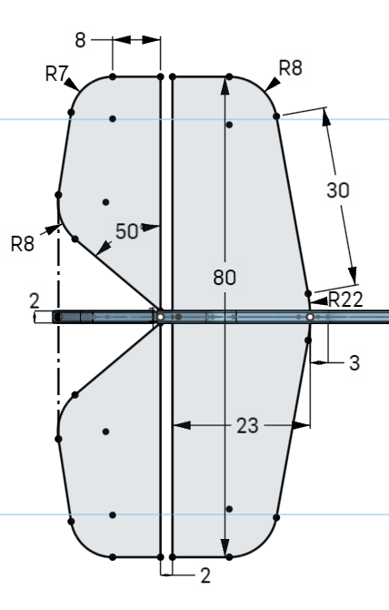
Horizontal Tail Dimensions:
Notes:
It is centered on the lines that create the fuselage
It is symmetrical
All curves are tangent to the lines they touch (which constrains it)

Slide 17
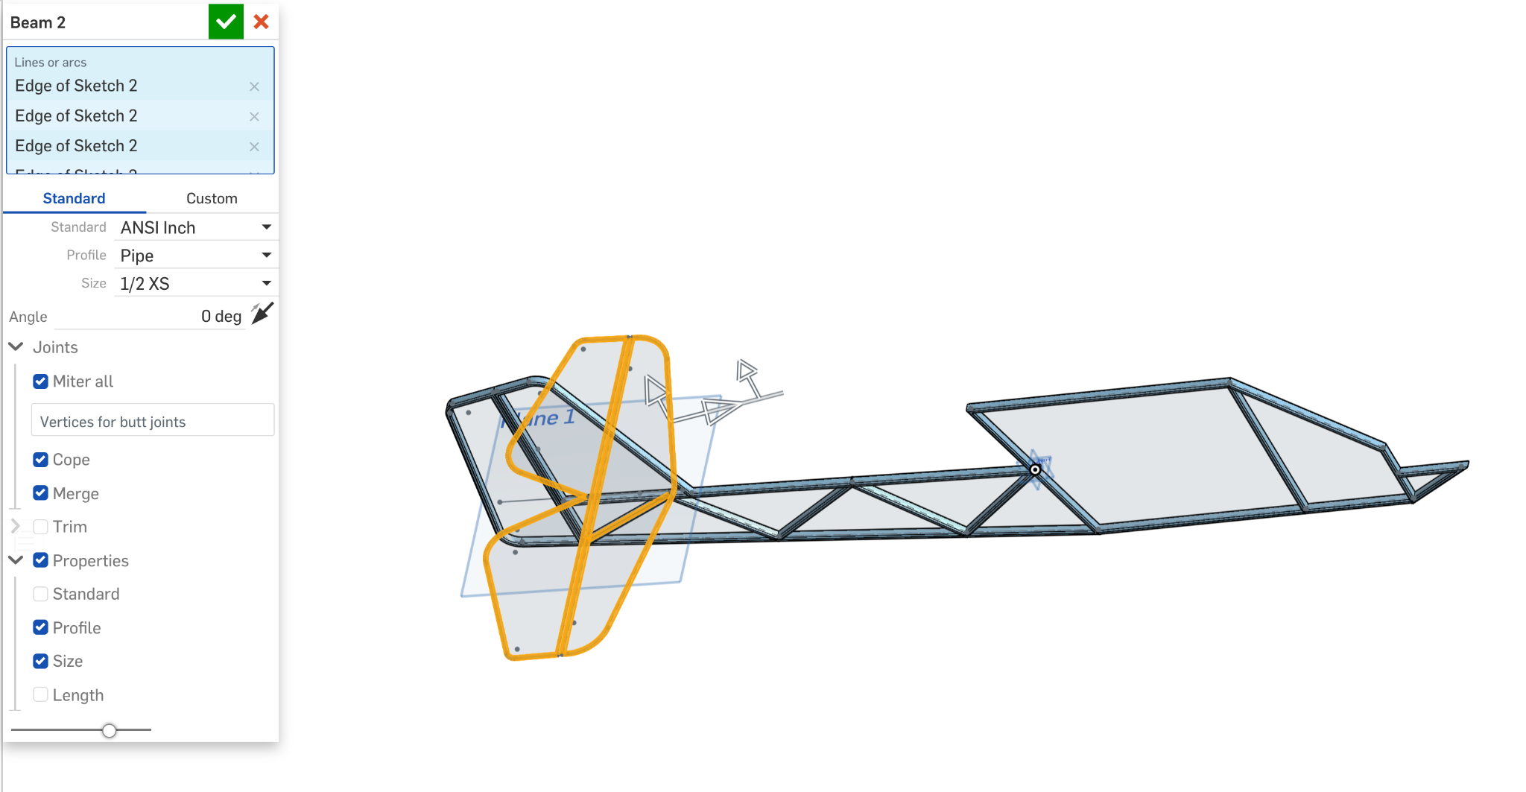
Once you’re done sketching, you can use the beam feature to pipe your tail just as you did with the fuselage (but maybe change the settings).

Slide 18
5 minutes — share your design in breakout rooms and revise!

Slide 19
Anyone willing to share?

Slide 20
Thank you!
You now have your own plane in Onshape!

